Slide 1

Intelligent Campus Facilities and Maintenance Management System
COURSE CODE: CSA1003
SOFTWARE ENGINEERING
PRESENTED BY:
Suriya Priya K (192521195)
Anjali Oviya U (192521452)
GUIDED BY:
DR.ARIVUKARASI M

Slide 2
Abstract
CampusCare is a centralized web-based platform designed to simplify campus maintenance management. It allows students to report maintenance issues, track their requests, and receive status updates. Technicians can manage and resolve assigned issues, while administrators can monitor the complete maintenance process through a centralized system. The platform also uses priority scoring to help identify urgent issues and reduce delays in resolution.

Slide 3
INTRODUCTION
CampusCare is a centralized web-based campus facilities and maintenance management system.
It helps students report maintenance issues such as water leakage, broken furniture, and electrical problems.
It uses priority scoring to identify urgent maintenance issues.
Tools Used: HTML, CSS, and JavaScript are used for frontend development, Python Flask for backend operations, SQLite for database management, and VS Code for coding and testing
Priority-Based Scoring Algorithm is used to calculate the priority of maintenance requests and identify urgent issues for faster resolution

Slide 4
Problem Statement
Campus maintenance complaints are scattered across different channels, making them difficult to track.
Delayed priority decisions and status updates can slow down maintenance issue resolution.

Slide 5
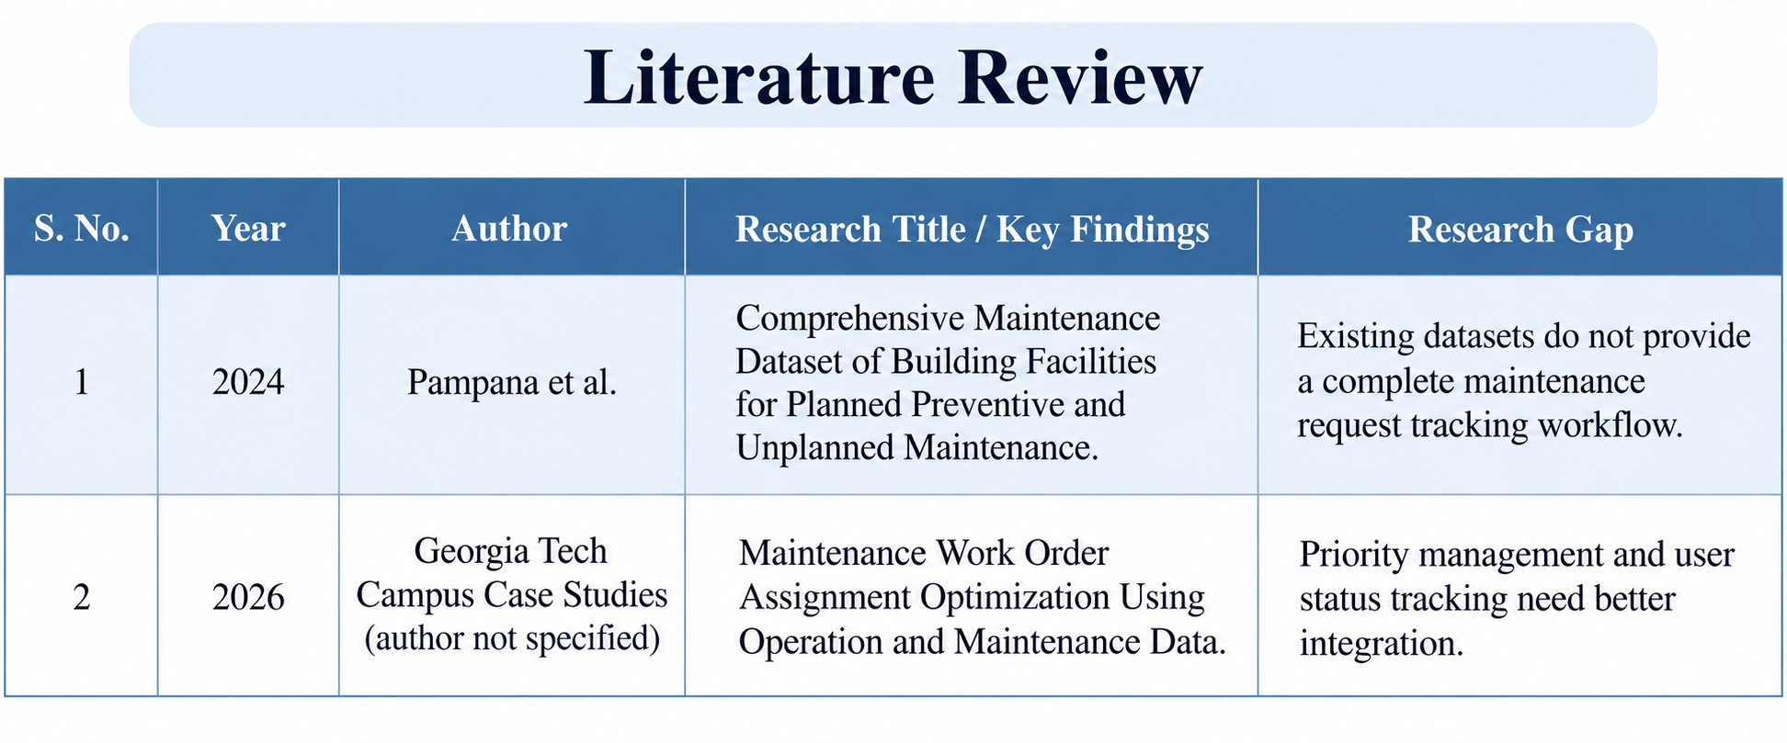

Slide 6
Objective
To centralize maintenance reporting and tracking through a single campus platform and to improve priority management and reduce delays in maintenance issue resolution.

Slide 7
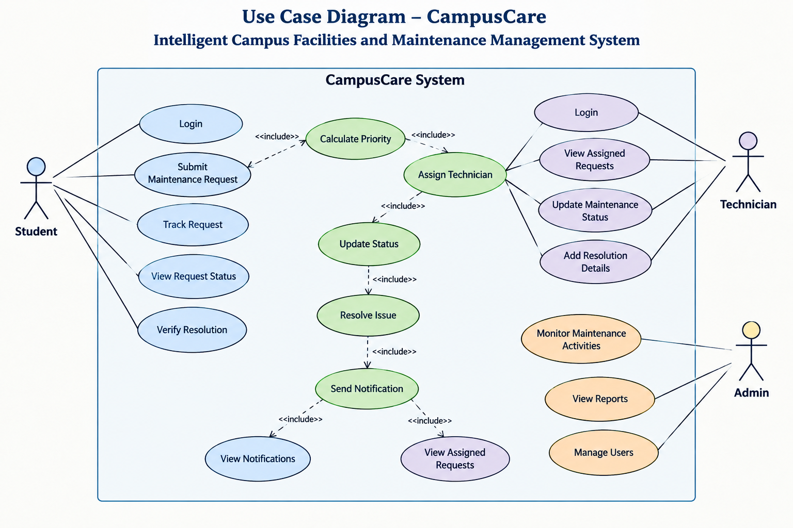

Slide 8
Module 1: Student Request & Tracking
Students can submit maintenance requests through their personal dashboard.
Each request receives a unique identification number for tracking.
Students can view current status and request activity updates.
Request details include category, location, description and priority information.

Slide 9
Module 2: Technician & Admin Management
Technicians can accept requests and update maintenance progress.
Status changes follow Submitted, Assigned, In Progress and Resolved stages.
Technicians can record inspection and resolution details.
Administrators can monitor overall maintenance statistics and activities.

Slide 10
Student Login
Submit Maintenance Request
Priority Score Calculation
Technician Assignment
Working Flow
Admin Monitoring
Student Verification
Issue Resolved
Work In Progress

Slide 11
Tools Used
HTML creates the structure and content of the website pages.
CSS designs the layout, appearance and responsive interface.
JavaScript manages interactive elements and dynamic website behaviour.
Python Flask handles backend operations, routing and maintenance workflows.
SQLite stores users, requests, statuses, notes and activity records.
VS Code supports website development, testing and project management.

Slide 12
Conclusion
CampusCare provides a centralized and efficient solution for managing campus maintenance activities. It connects students, technicians, and administrators through a single platform, enabling easy issue reporting, priority-based assignment, real-time status tracking, and resolution verification. By reducing scattered complaints and improving coordination, the system helps minimize delays and supports faster and more transparent maintenance management.

Slide 13
References
1. Pampana et al. (2024)
Comprehensive Maintenance Dataset of Building Facilities for Planned Preventive and Unplanned Maintenance.
Data in Brief, 57, 110845.
2. Work Order Assignment Optimization (2026)
Maintenance Work Order Assignment Optimization Using Operation and Maintenance Data.
Georgia Tech Campus Case Studies.

